Slide 1
Guide To Integrate PayPal in your Project
Navashikha Kandel
200463297

Slide 2
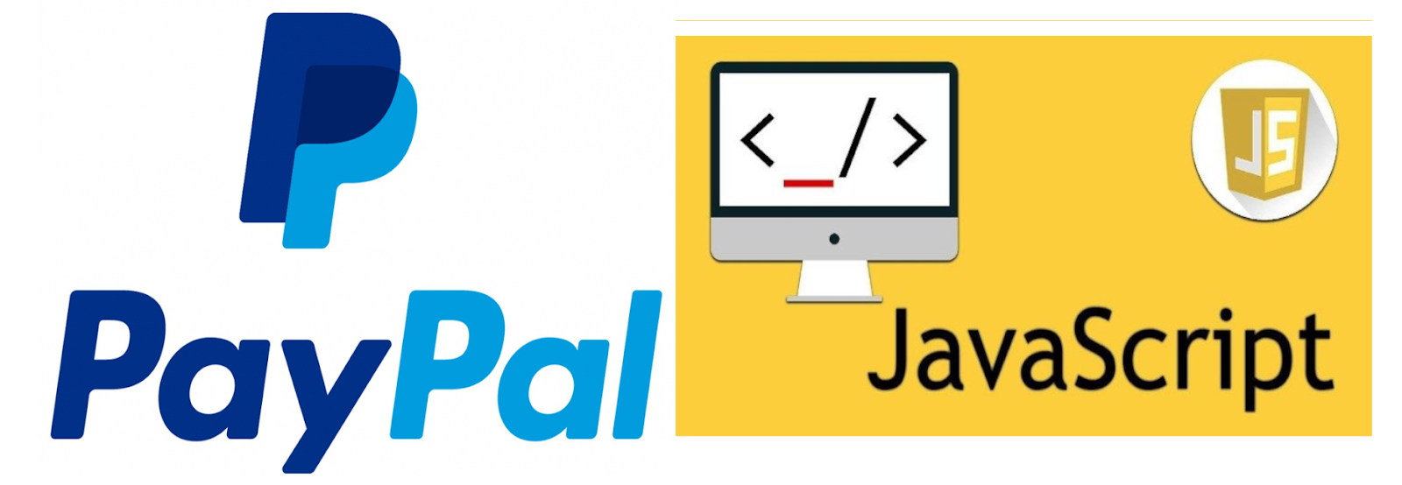
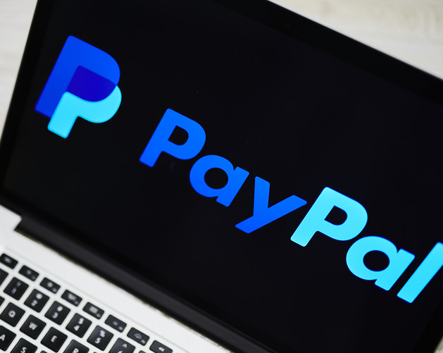
Introduction
PayPal is a payment gateway alternative that provides convenient solutions for businesses and individuals.
Approx. 70% shopping cart abandonment rate = less user- friendly experience
PayPal Checkout cuts down on the number of actions a customer must take before completing their purchase.

Slide 3
How?
PayPal in a JS Project

Slide 4
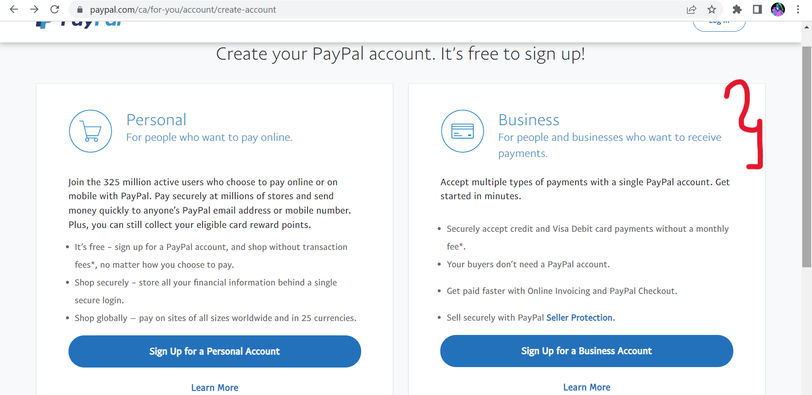
1. Create a business account
https://www.paypal.com/ca/for-you/account/create-account

Slide 5
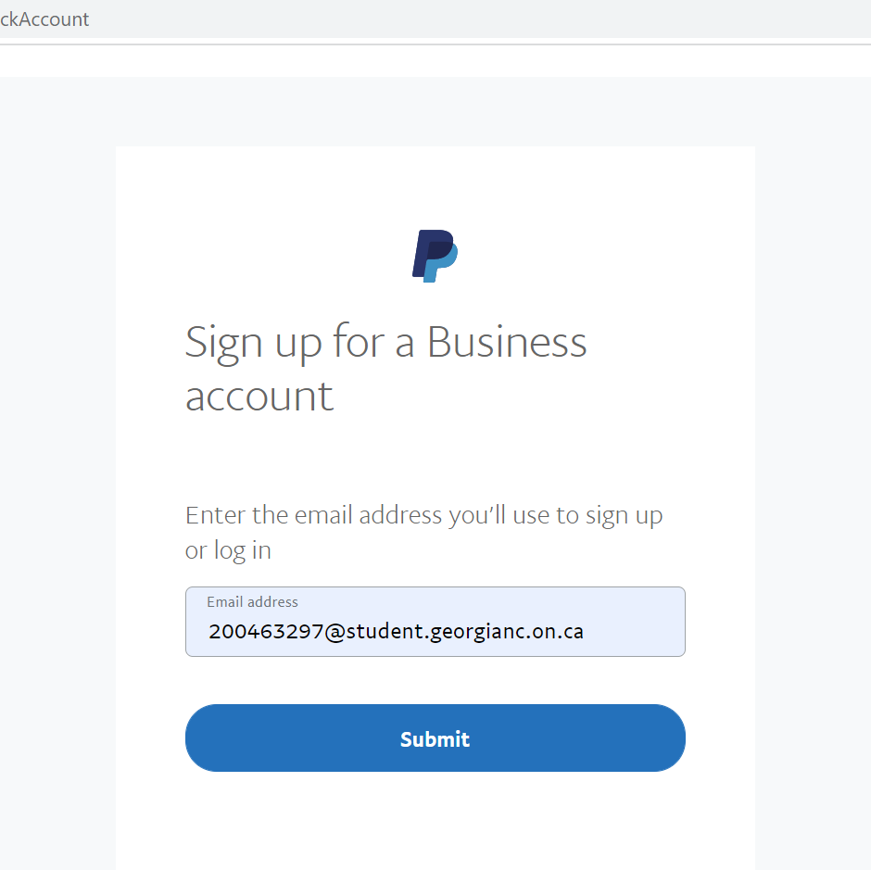
2. Add your credentials

Slide 6
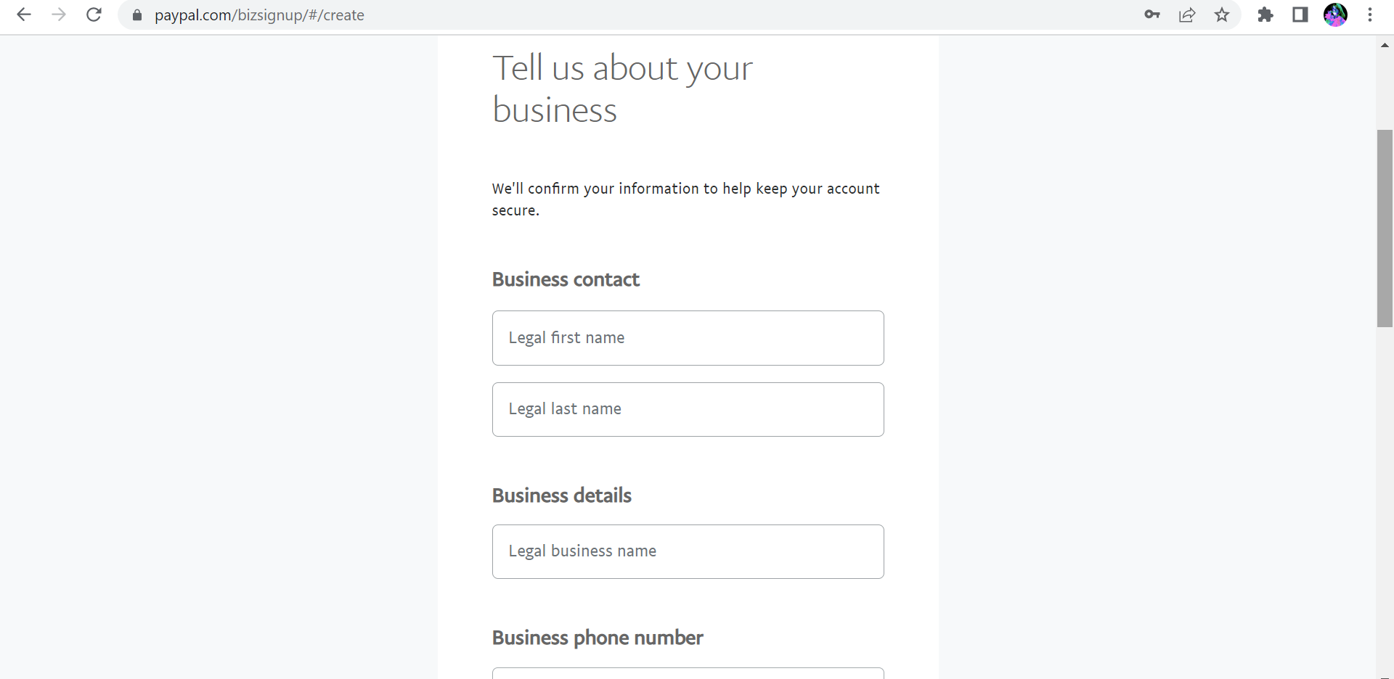
3. Select Georgian College as your business

Slide 7
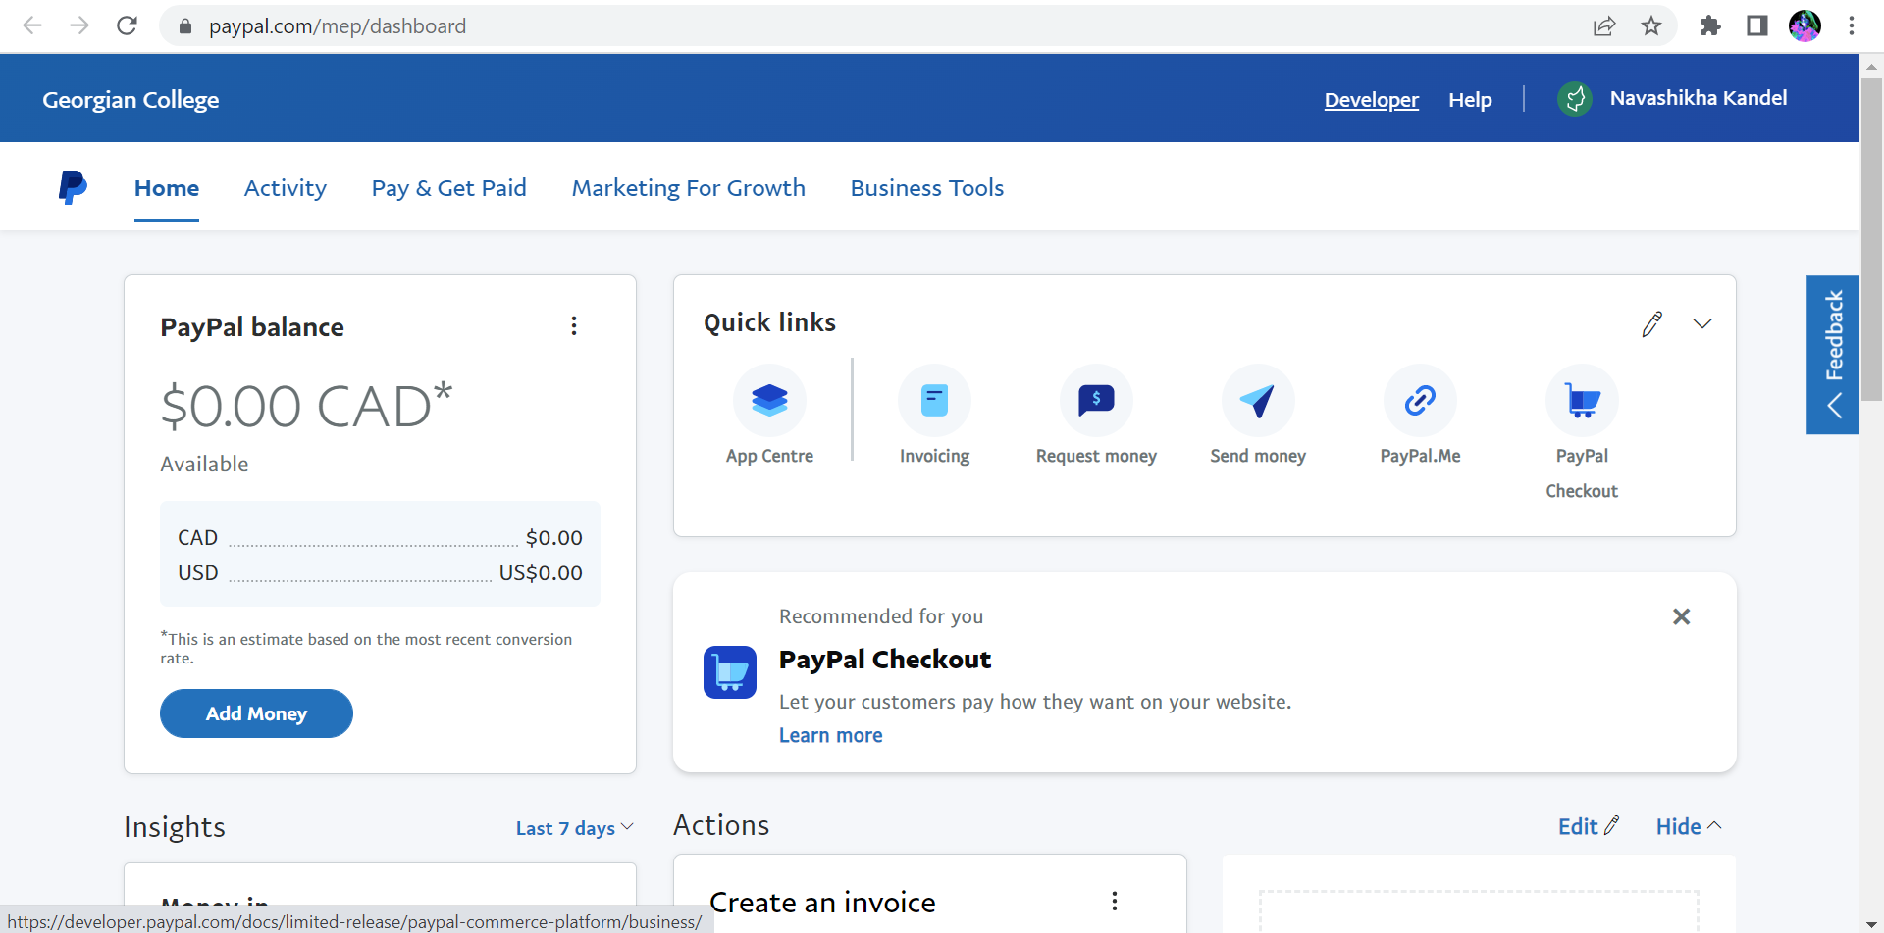
4. Once your account is successfully created, go to dashboard

Slide 8
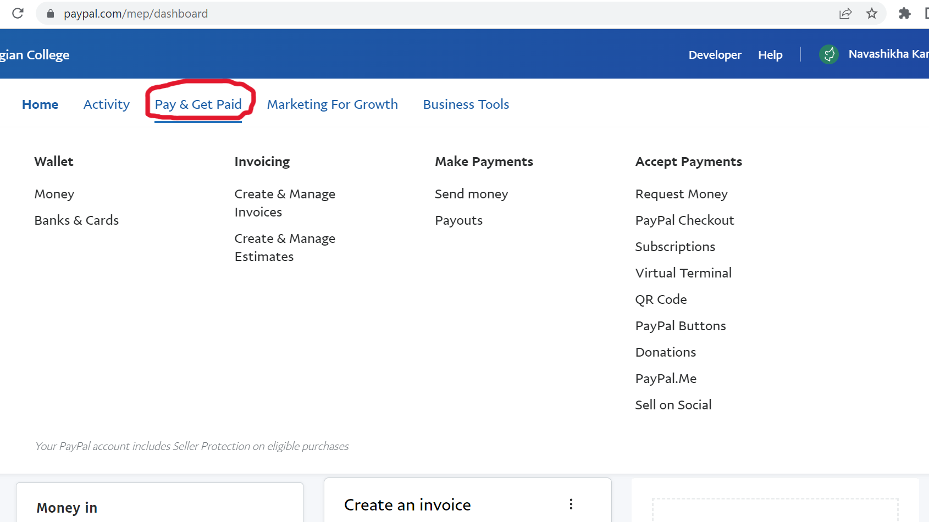
5. Pay & Get Paid

Slide 9
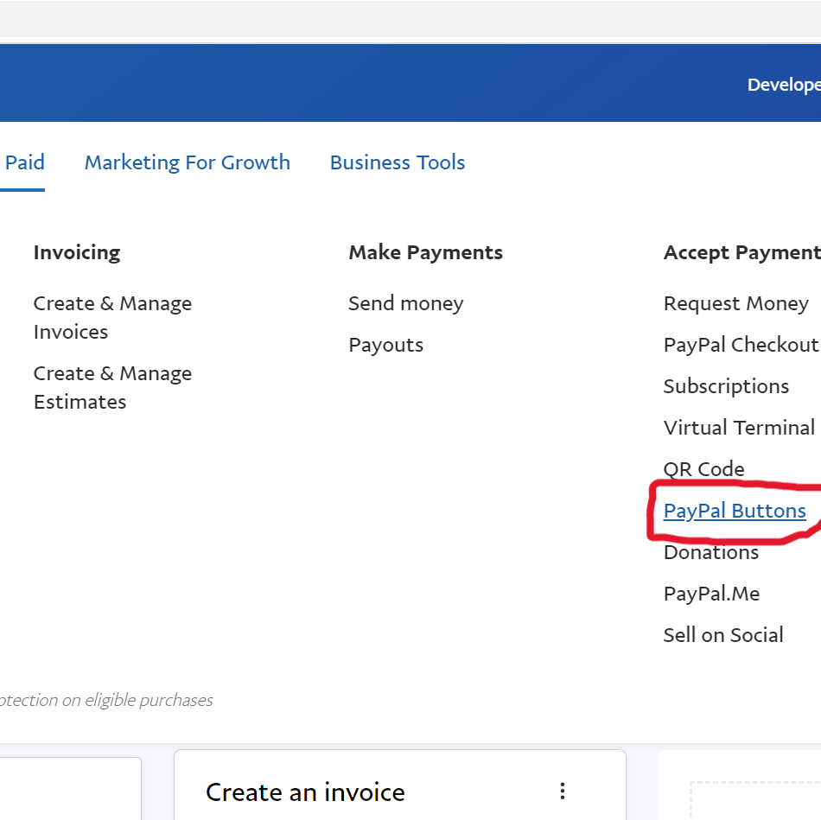
6. Select PayPal Buttons

Slide 10
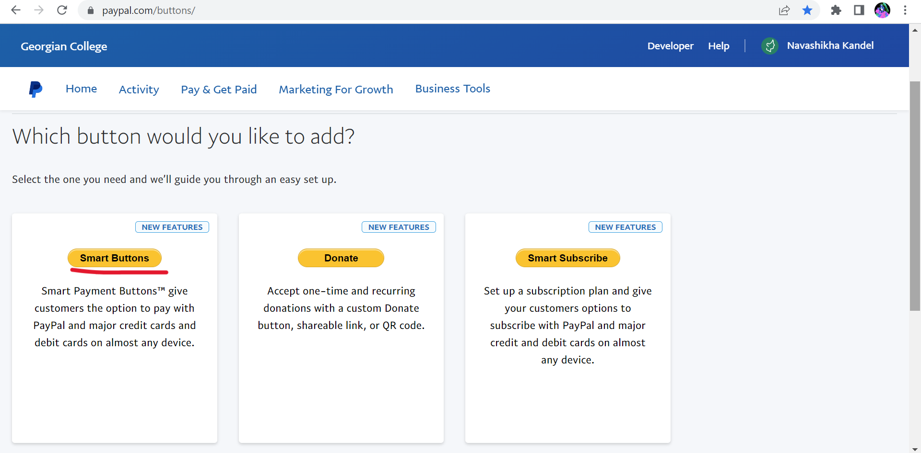
7. There are multiple types of button select the on that works best for you. I selected Smart Buttons.

Slide 11
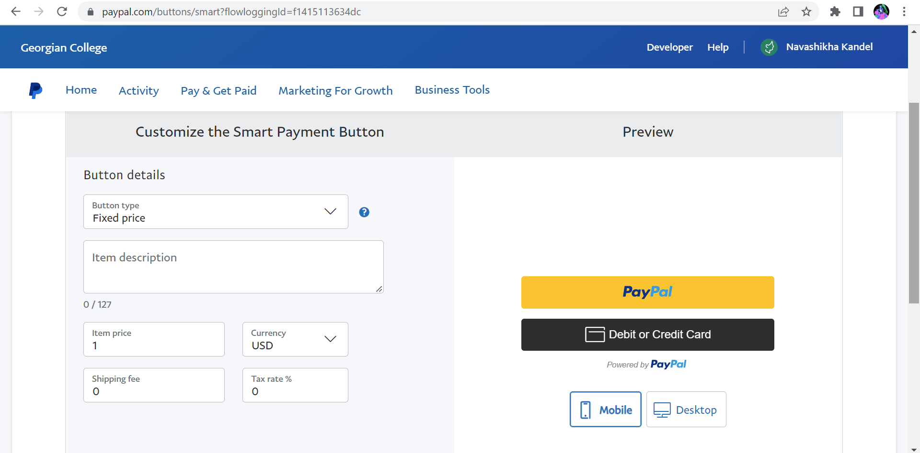
8. Customize the button

Slide 12
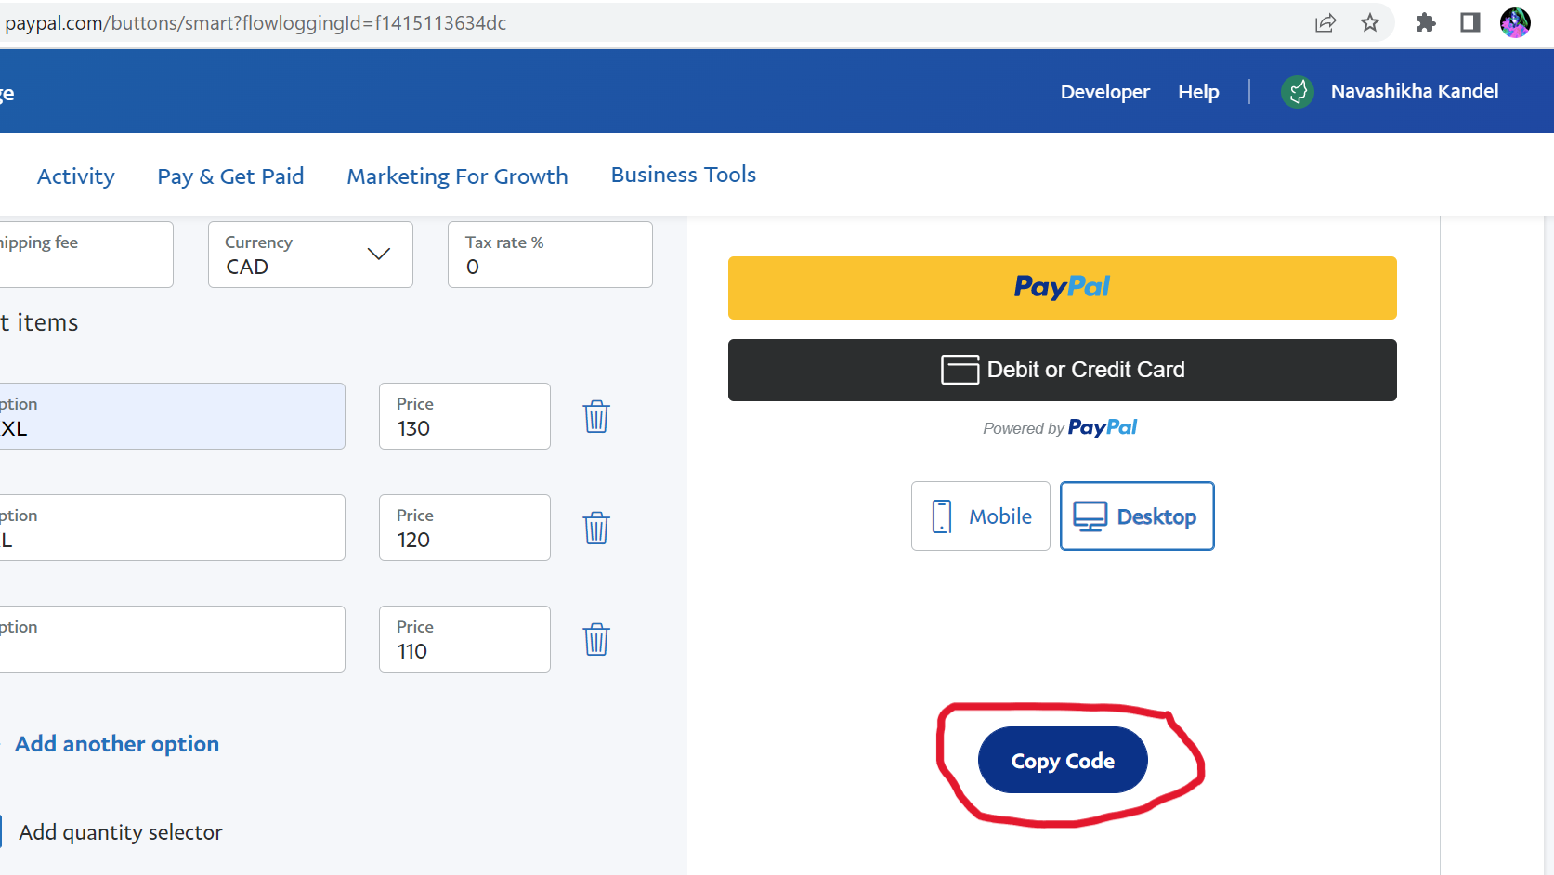
9. The code will be automatically generated by PayPal. Select copy and paste it to VS code.

Slide 13
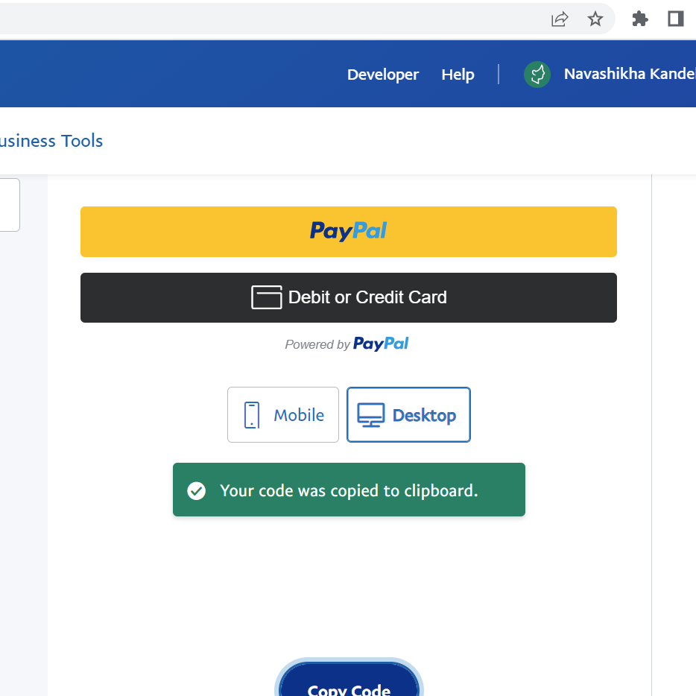

Slide 14
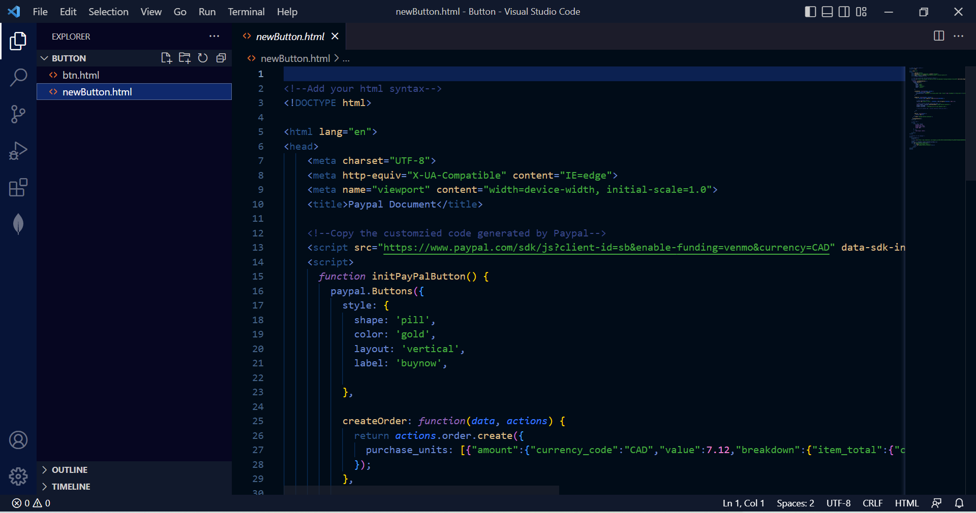
Add your HTML syntax and paste it

Slide 15
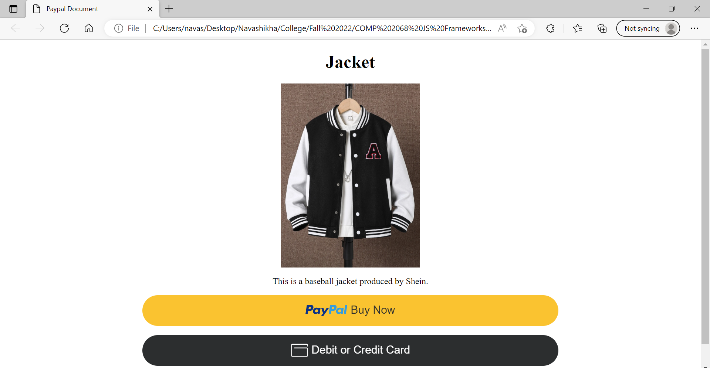

Slide 16
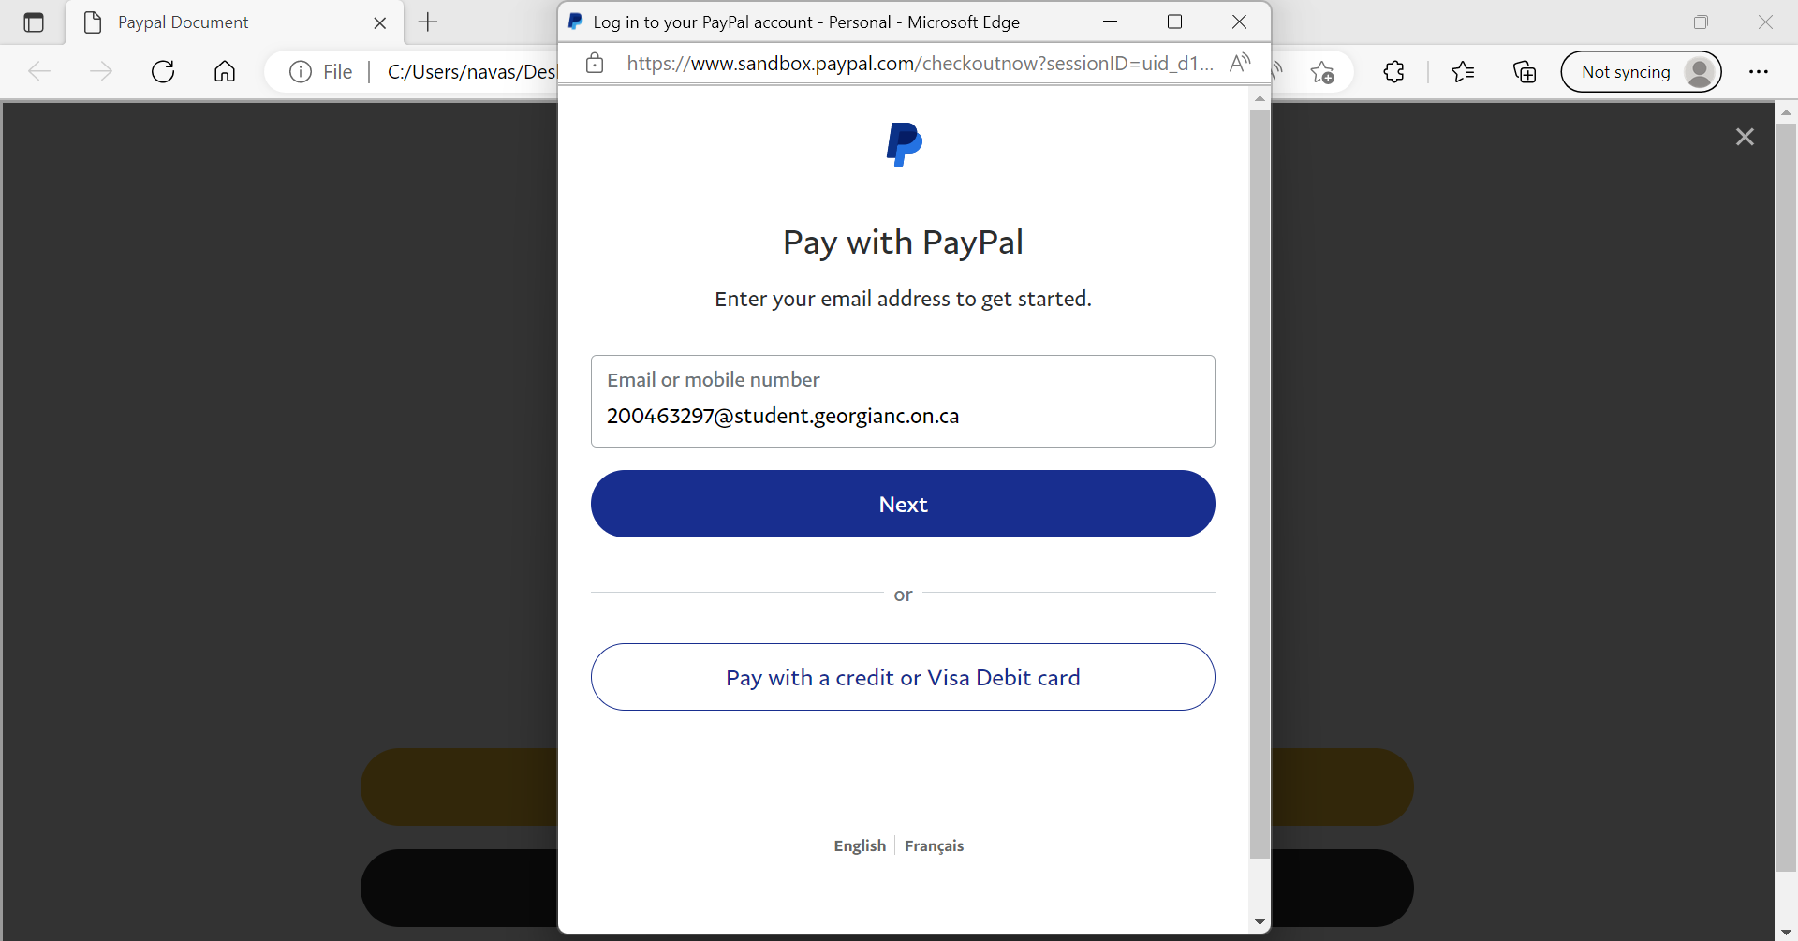

Slide 17
Thank you
ANY QUESTIONS?

